Slide 1

Smart Shoe for Wireless Ground Reaction Force Monitoring using
Pressure Sensors and Machine Learning
Dhruv Shambhu Thakkar
(Research Intern, HCR Lab, IIT Gandhinagar)
Indian Institute of Technology Gandhinagar

Slide 2
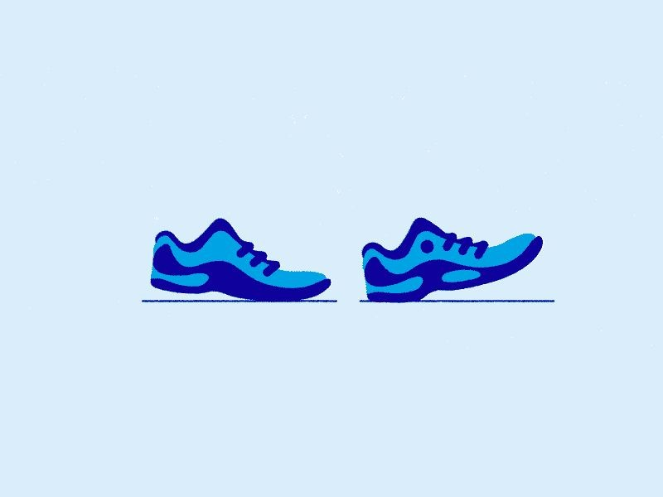
Workshop Reviews
Why there are only 4 pressure pads?
How do you validate these pressure and force values?
What type of foot model can be used ?
Have you compared this insole with market-ready insoles ?
Indian Institute of Technology Gandhinagar

Slide 3

Next Steps
New Hardware selection
Teensy do not have Wi-fi and BLE. It is good for ML model deployment but do we really need to deploy the model ????
In future if we need some real time displays or any user friendly UI, we will need to establish the wireless connection with the shoe.
We need something which has 2 I2C ports, Wi-fi or BLE and SD card slot is optional (external module can be used).
ESP 32, ESP 8266, Raspberry pi pico and STM 32 can be good options. These will reduce the size of the sensor box as well.
Indian Institute of Technology Gandhinagar

Slide 4
Next Steps
New Activity Plan
Initially check the current squat model with different activities.
Train a model with output as Fz, Fx and Fy together so that we can figure out should we proceed with only Fz or not.
Activity will be of 5 min ( 2 min sit-to-stand ,1 min rest, 2min squatting)
We will train total 3 models with this activity one for each activity alone and one combined and then will compare the results.
Indian Institute of Technology Gandhinagar

Slide 6
Introduction
[1]
[1] Bonnefoy-Mazure, A. & Armand, Stéphane. (2015). Normal gait.

Slide 7
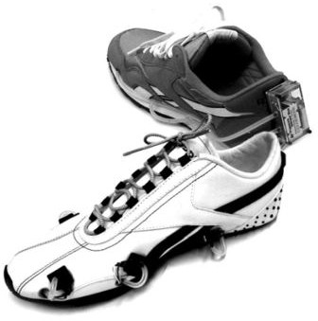
Literature Review
2. A Wireless Human Motion Monitoring System for Smart Rehabilitation:
The paper introduces a new analysis method that utilizes fuzzy logic to continuously and smoothly detect gait phases, enabling a comprehensive utilization of GCF sensor information.
Additionally, the paper presents a higher-level algorithm that quantitatively monitors abnormalities in human gait, including improper GCF patterns and incorrect gait phase sequences.
The proposed methods are implemented using sensor-embedded shoes, referred to as smart shoes, which feature four GCF sensors installed between the cushion pad and the sole.
Overall, the research paper introduces an approach to gait monitoring using air pressure sensors and provides insights into the detection of gait phases and abnormalities, offering potential applications in advanced rehabilitation systems.
[3]
[3] Kong, Kyoungchul, and Masayoshi Tomizuka. "A gait monitoring system based on air pressure sensors embedded in a shoe." IEEE/ASME Transactions on mechatronics 14.3 (2009): 358-370.

Slide 8
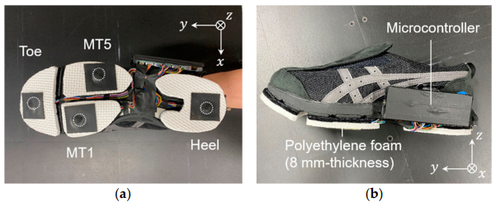
Literature Review
3. This work develops a shoe sole sensor system with high-capacity, compact triaxial force sensors to estimate three-directional ground reaction forces (GRFs) during walking and turning movements. By utilizing Cr–N strain-sensitive thin films mounted at key points on the shoe sole, the system captures detailed GRF data, which is then processed using machine learning models, including multiple linear regression (MLR) and Gaussian process regression (GPR). The results demonstrate that the GPR model effectively predicts GRFs in the y and z directions with a prediction error of less than 15%, showing strong agreement with force plate measurements
[3]
[5] Prediction of Three-Directional Ground Reaction Forces during Walking Using a Shoe Sole Sensor System and Machine Learning

Slide 9
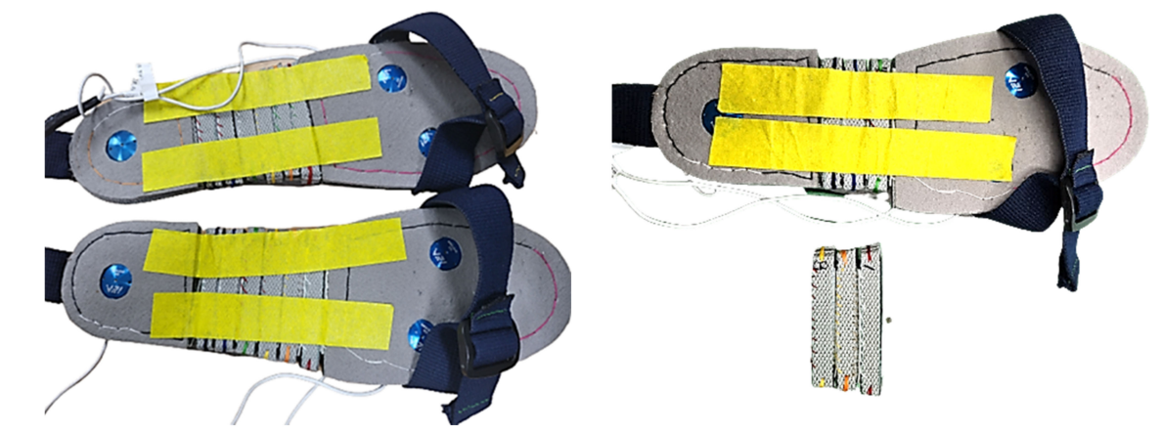
Literature Review
3. This paper presents a method for estimating three-axis ground reaction forces (GRFs) during walking using shoes equipped with three uniaxial EzForce-1D optical load cells and a sequence-to-sequence Long Short-Term Memory(seq2seq LSTM) model. The load cells, placed on the 1st metatarsal, 5th metatarsal, and mid-heel regions, were designed to minimize distortion and adapt to different foot sizes. The collected data was used to predict vertical, anterior-posterior (AP), and medial-lateral (ML) GRFs. The experiment involved 81 healthy adults walking at their preferred speed, with GRF measured using force plates as a reference. The LSTM model was trained with resampled and filtered data from 109 sets and validated with separate test sets.
[3]
[6] A Deep Learning Model for 3D Ground Reaction Force Estimation Using Shoes with Three Uniaxial Load Cells

Slide 10
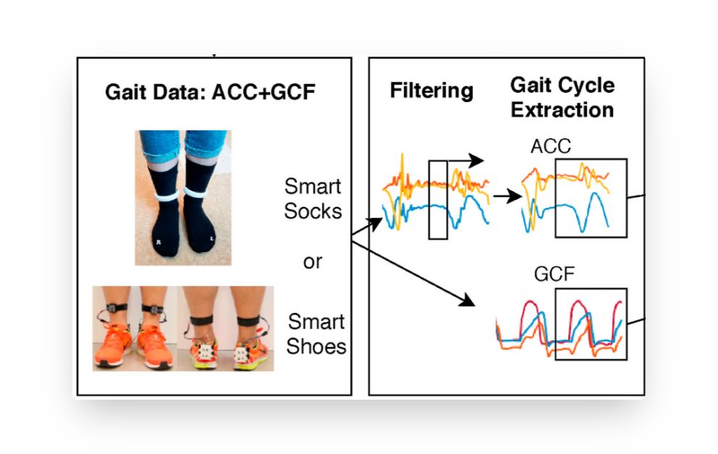
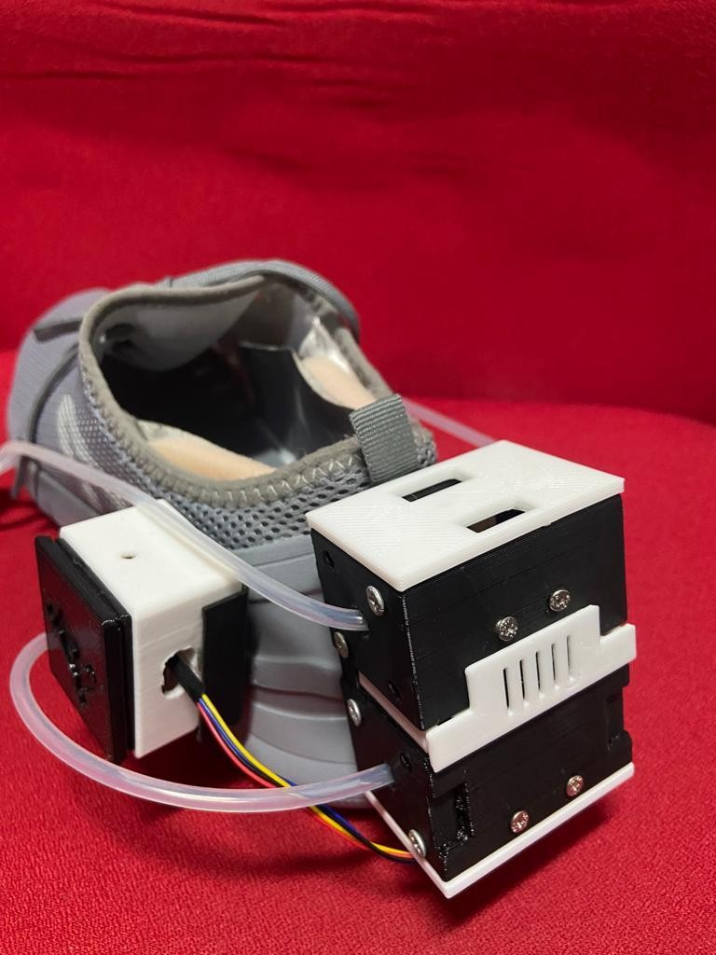
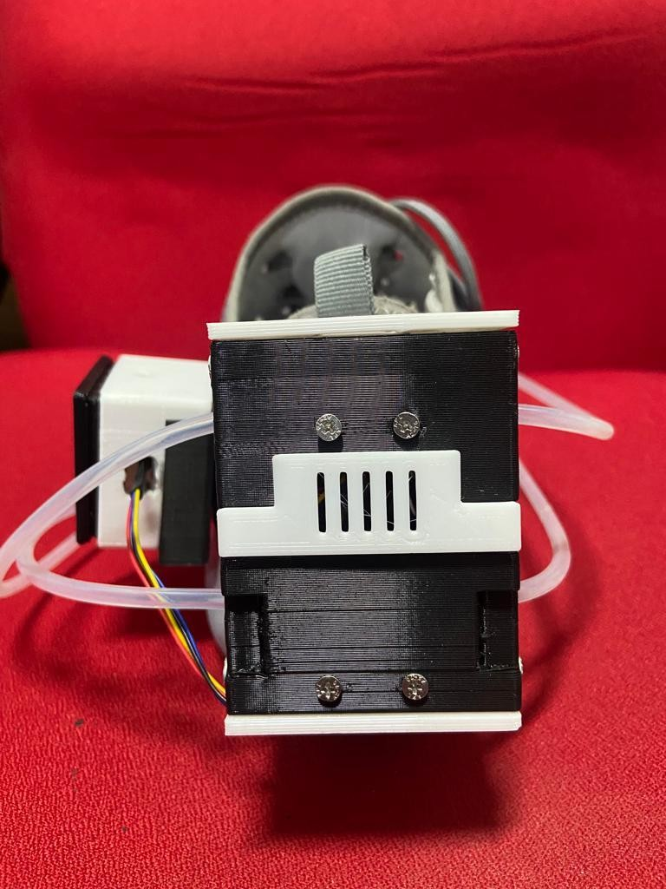
Project Phases
Experiment to obtain Raw Data & Ground Truth
Sensor Fusion & Data Synching
Feature Engg.
/Calibration
Model Real Time
Training Deployment
Indian Institute of Technology Gandhinagar

Slide 11
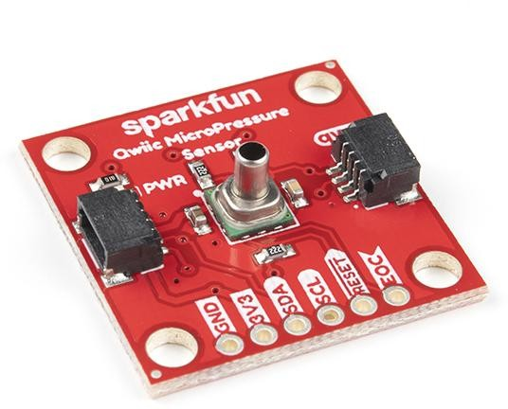
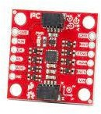
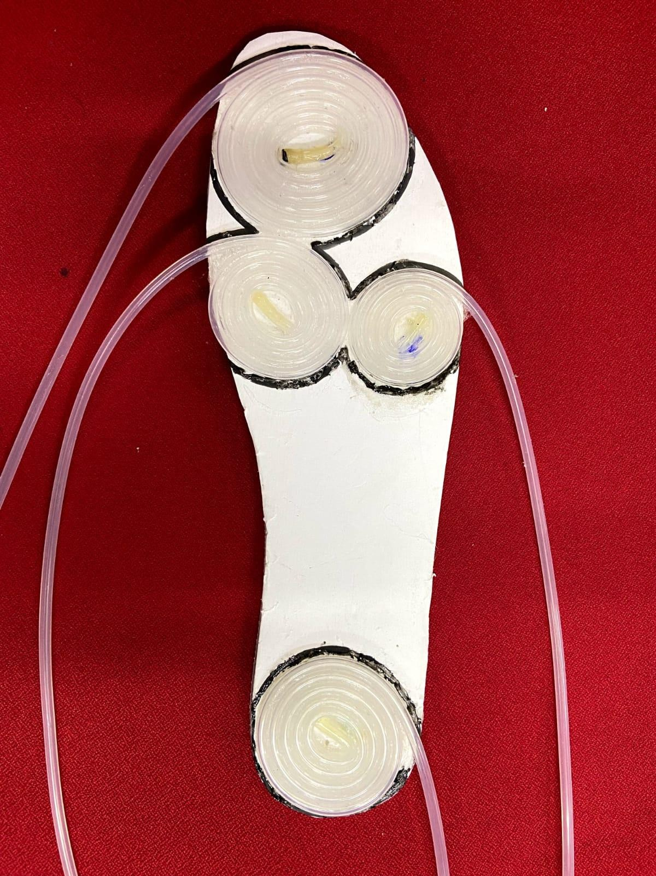
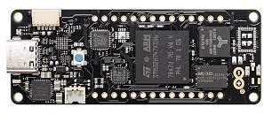
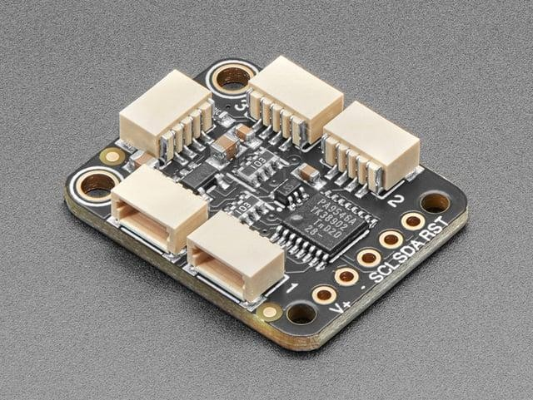
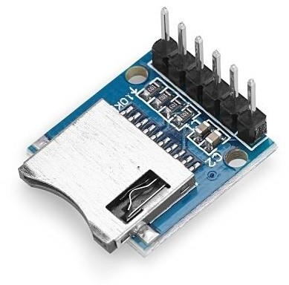
Sensors & Materials
[i]
[ii]
SparkFun Qwiic MicroPressure Sensor
Portenta h7
Sparkfun ICM-20948 9-dof IMU
[iii]
[iv]
[4]
Adafruit PCA9546
4-Channel Multiplexer
3.3V Micro SD module
[4] Shoe Insole with Silicone tube coiled pressure pads placed at: [i] Toe [ii] Metatarsophalengeal 1-2 [iii] Metatarsophalengeal 3-4 [iv] Heel

Slide 12
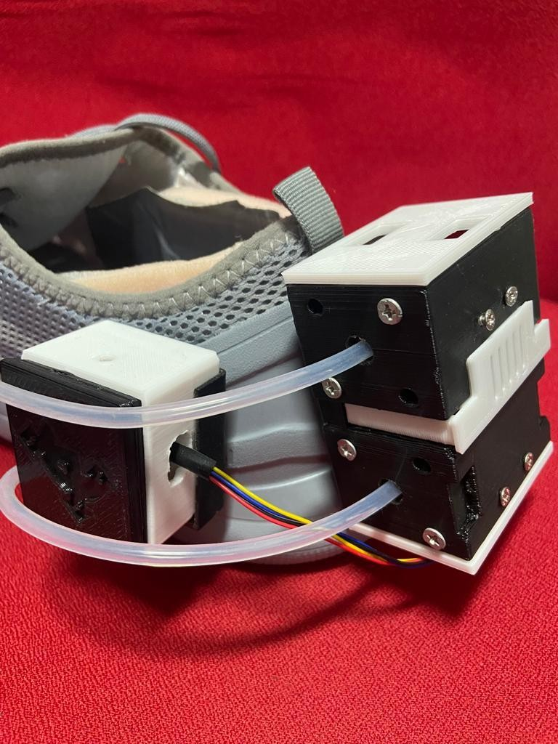
Experimental Design
Smart Shoe designed with 3D printed housing sensors to predict real time GRF

Slide 13
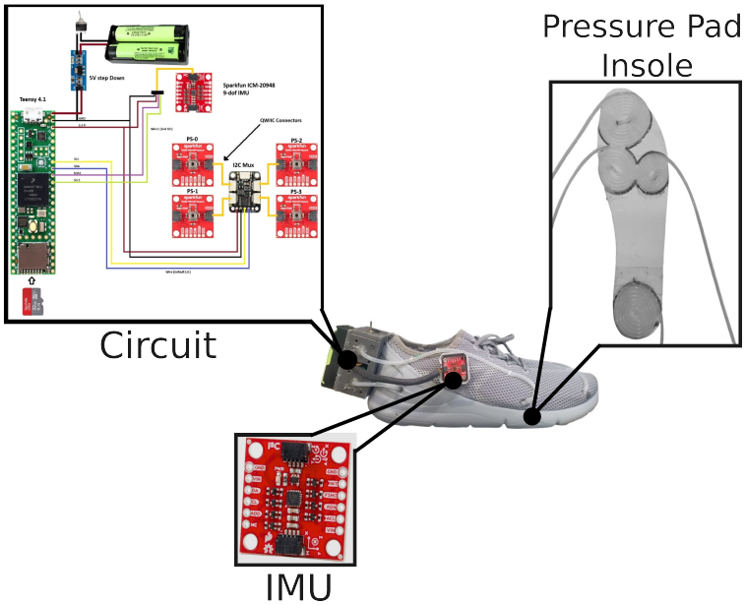
Experimental Design
Smart Shoe designed with 3D printed housing sensors to predict real time GRF

Slide 14
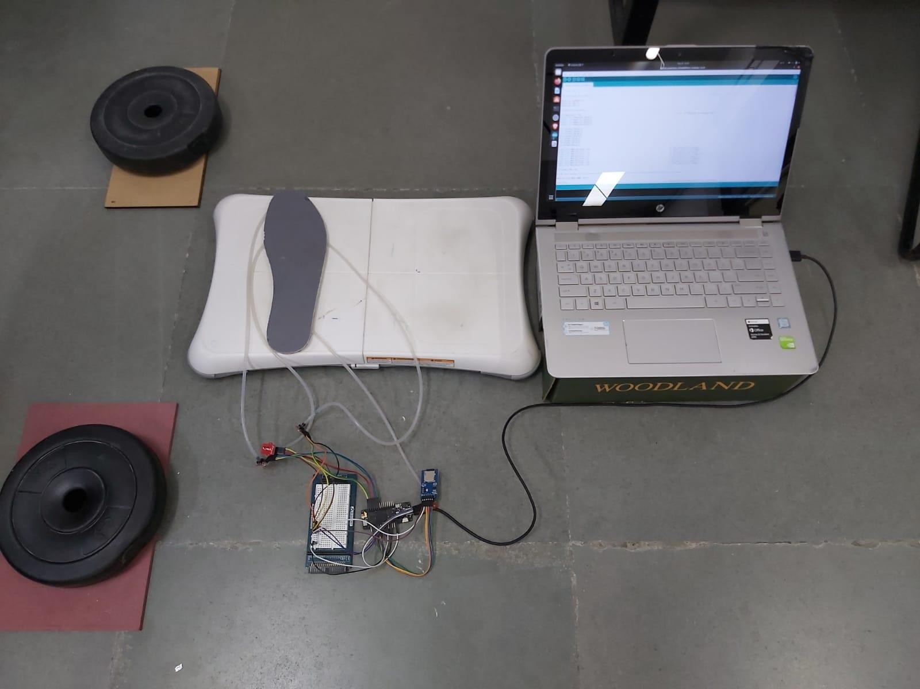

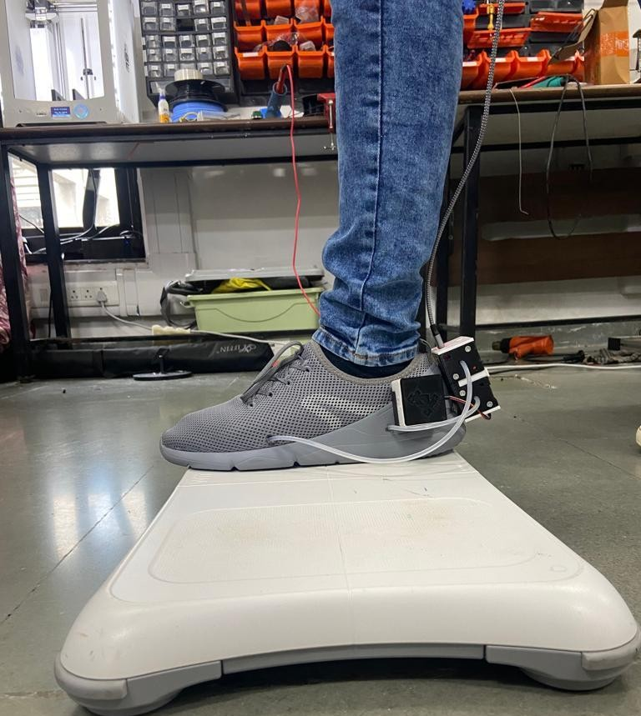
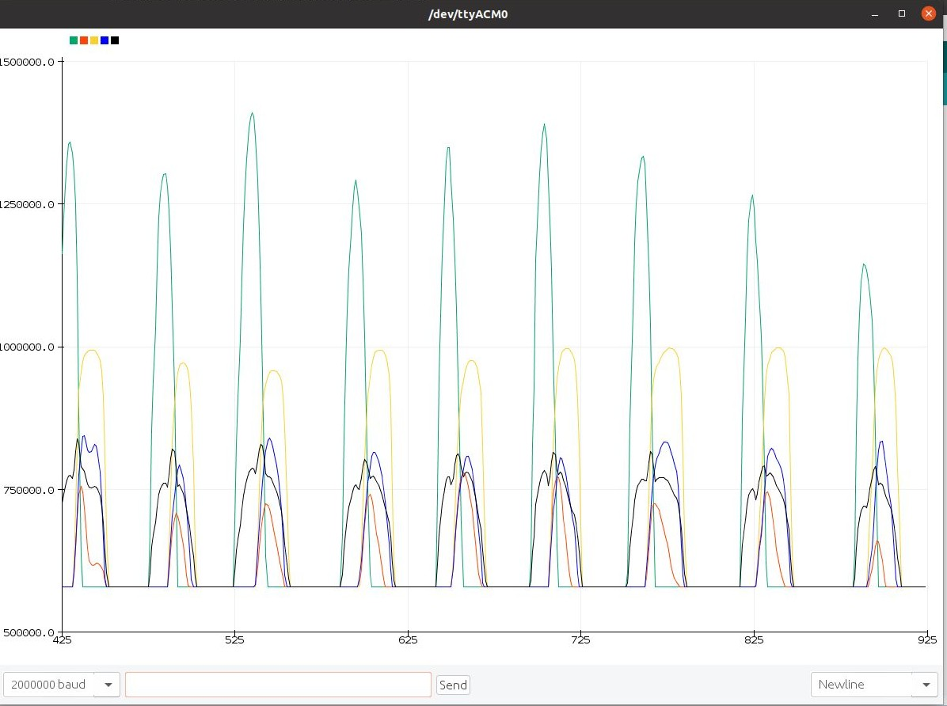
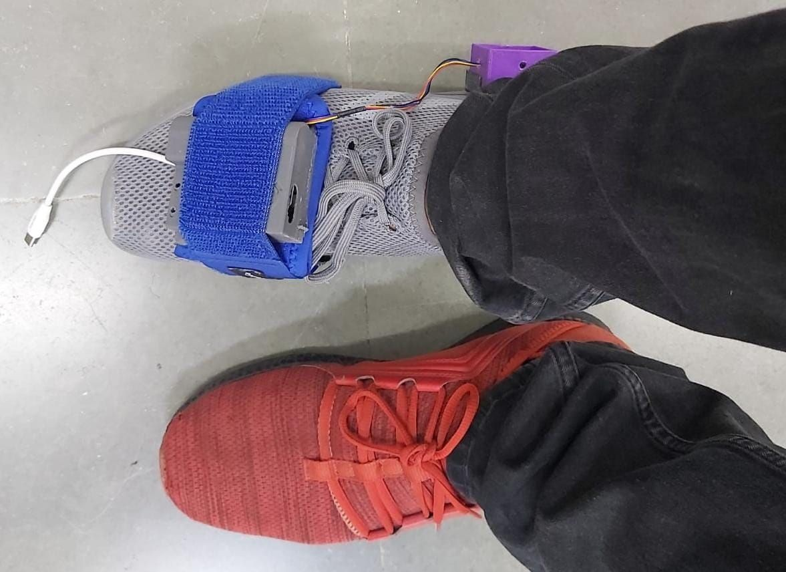
Data Collection
Before
Now
Indian Institute of Technology Gandhinagar

Slide 15
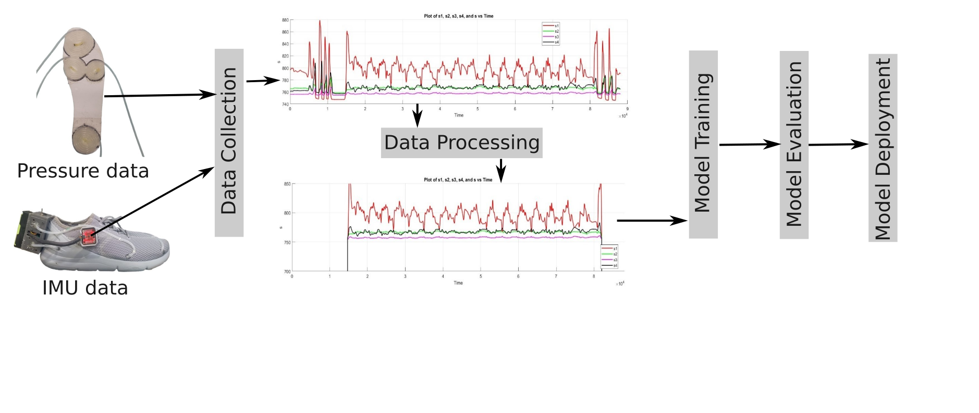
Data Collection
Indian Institute of Technology Gandhinagar

Slide 16
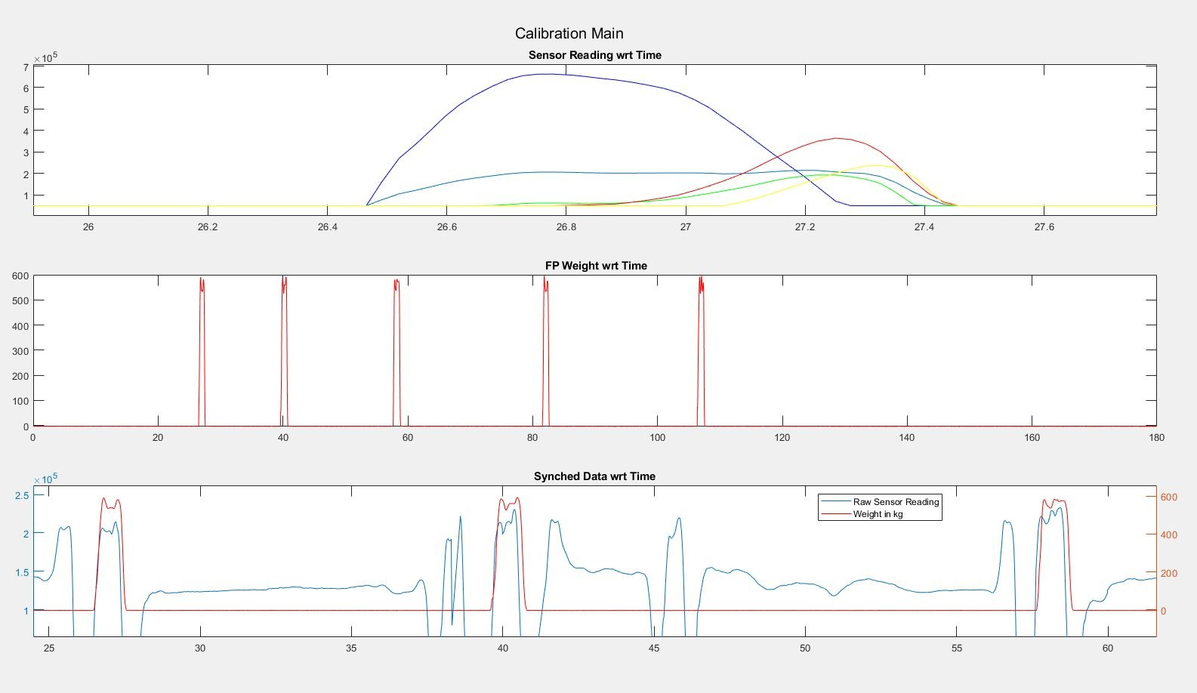


Data Synching & Calibration
Force Profiles
Force Plates
Smart Shoe
Similar Force Profiles obtained from Developed Smart Shoe and Force Plates

Slide 17
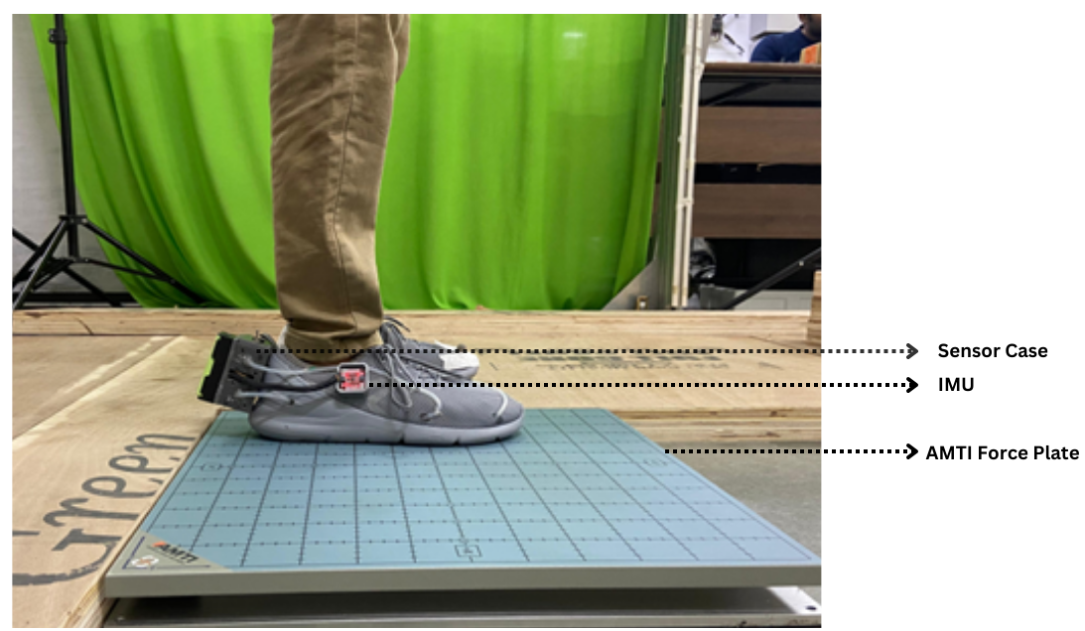

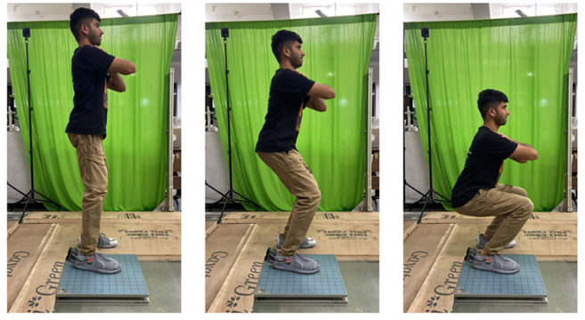
Data Collection
4 Subject Data Collected
3 bouts / speed
3 Different
trial
Experiments
Squatting Experiment
Indian Institute of Technology Gandhinagar

Slide 18
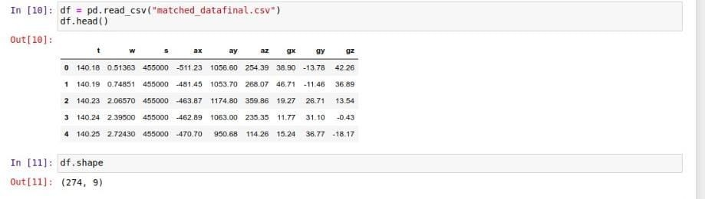
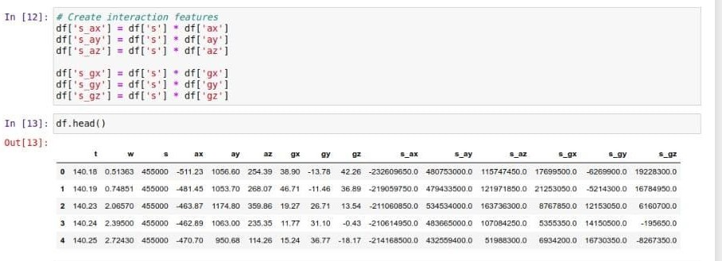
Data Visualization & Processing
Experiment Data Extraction from MATLAB
Importing Libraries, Loading Feature DataFrame
Normalizing Data and Creating Interaction Features
Indian Institute of Technology Gandhinagar

Slide 19
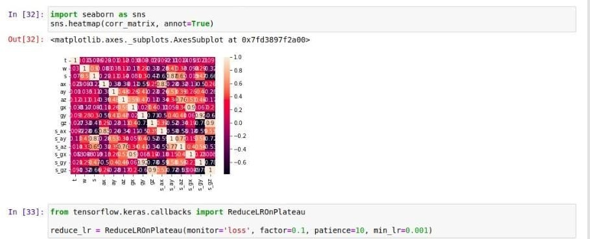
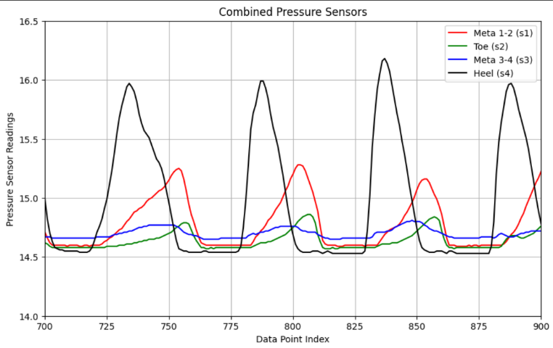
Visualizing Data, Outliers,
Distribution, Correlation Matrix
Splitting Data for Training and Testing
Model Training
Pressures sensor values during gait cycle
Indian Institute of Technology Gandhinagar

Slide 20
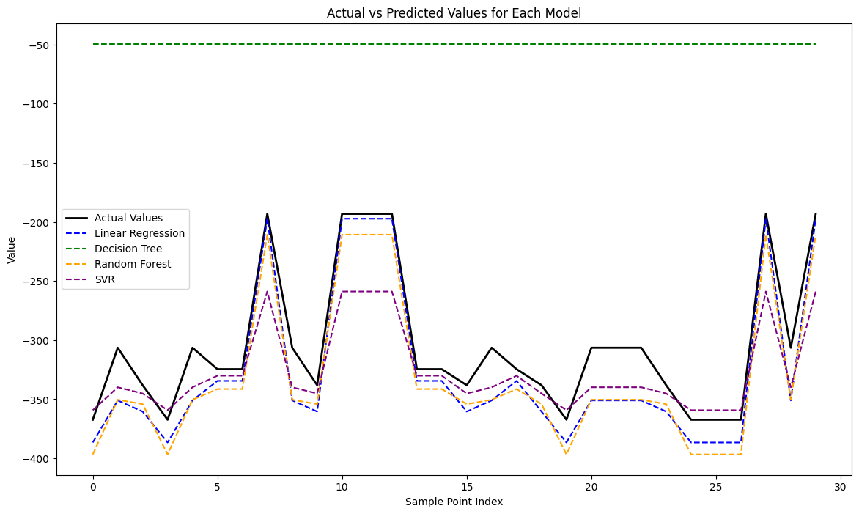
Model Training
Regression Techniques
Models Used:
Linear Regression (Baseline) (30%)
Decision Tree Regression (32%)
Random Forest Regression(38%)
Support Vector Regressor (SVR)(62%)
Regression MSE’s
Indian Institute of Technology Gandhinagar

Slide 21
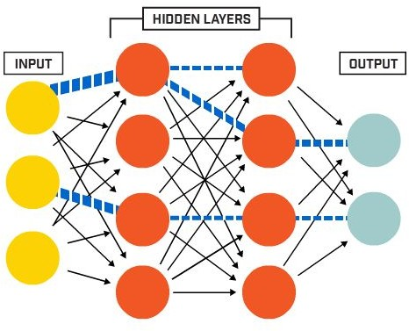
Model Training
Why Deep Learning?
Multiple Layers/hidden layers that distills some of the important patterns from the inputs and passes it onto the next layer
The activation function serves to capture non-linear relationship between the inputs, therefore it has the ability to learn and model non-linear and complex relationships
We started with a simple 2 layered network for baseline model, which itself gave 70 % accuracy and outperformed regression techniques.
Later by increasing the number of neurons and layers, also by adding Batch normalization , we have achieved accuracy of 93 %.
Indian Institute of Technology Gandhinagar

Slide 22
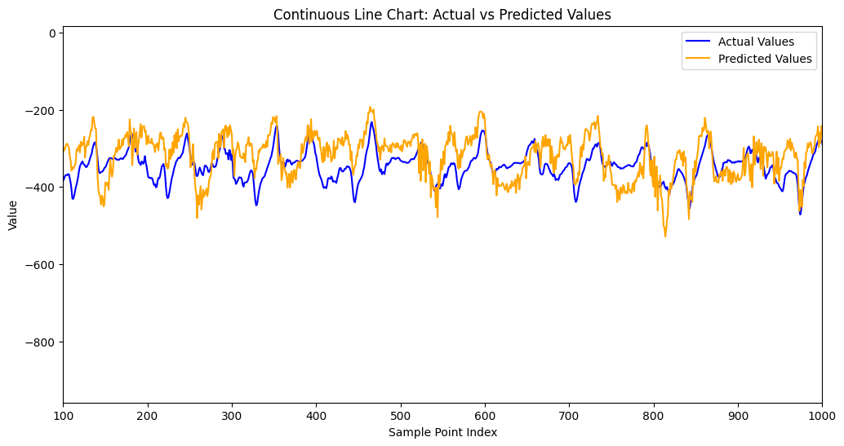
Deep Learning Output
Fresh subject squatting data
Indian Institute of Technology Gandhinagar

Slide 23

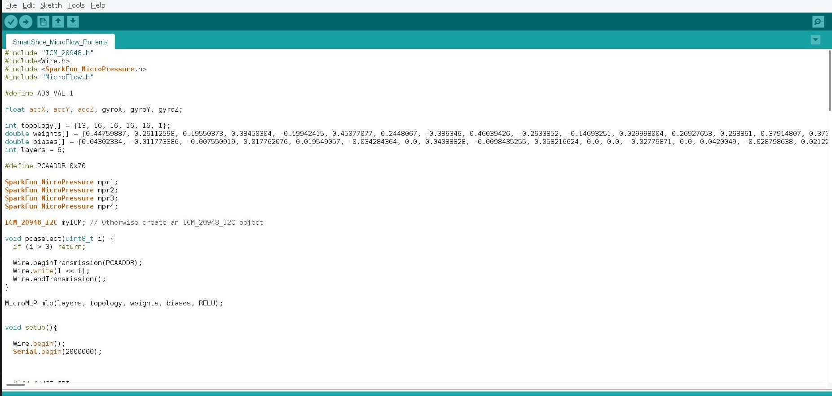
Model Deployment
MicroFlow
Quantized
Weights & Biases
Inference for Onboard Computation
Indian Institute of Technology Gandhinagar

